Slide 1
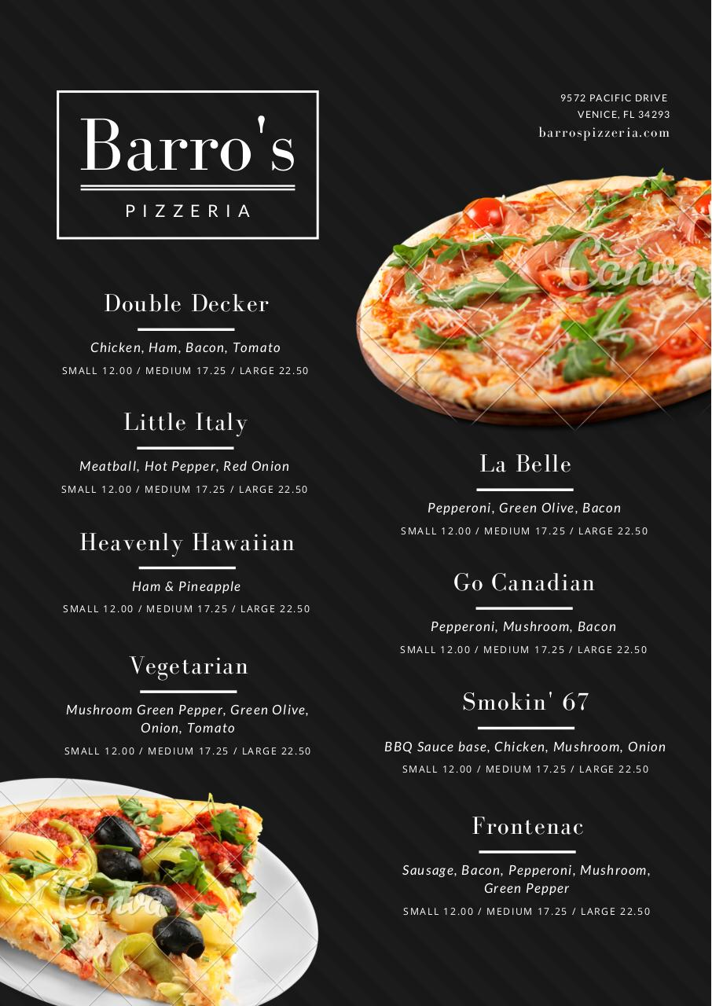


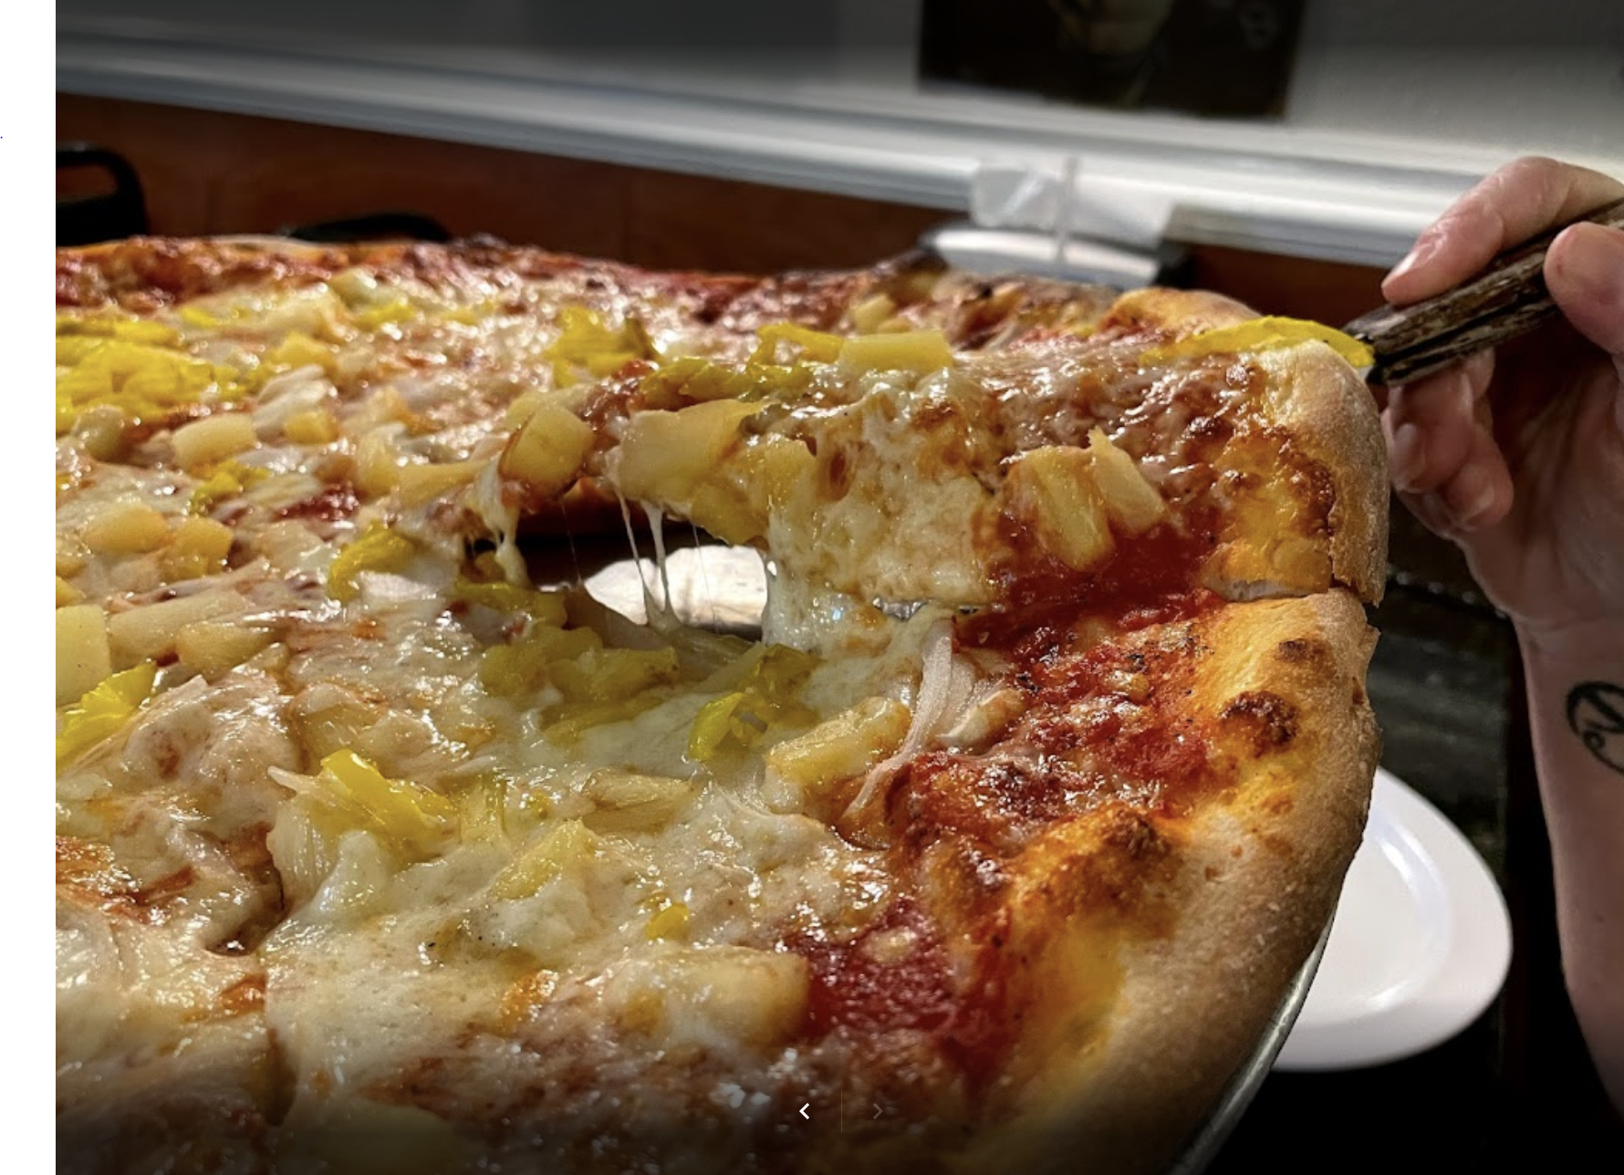

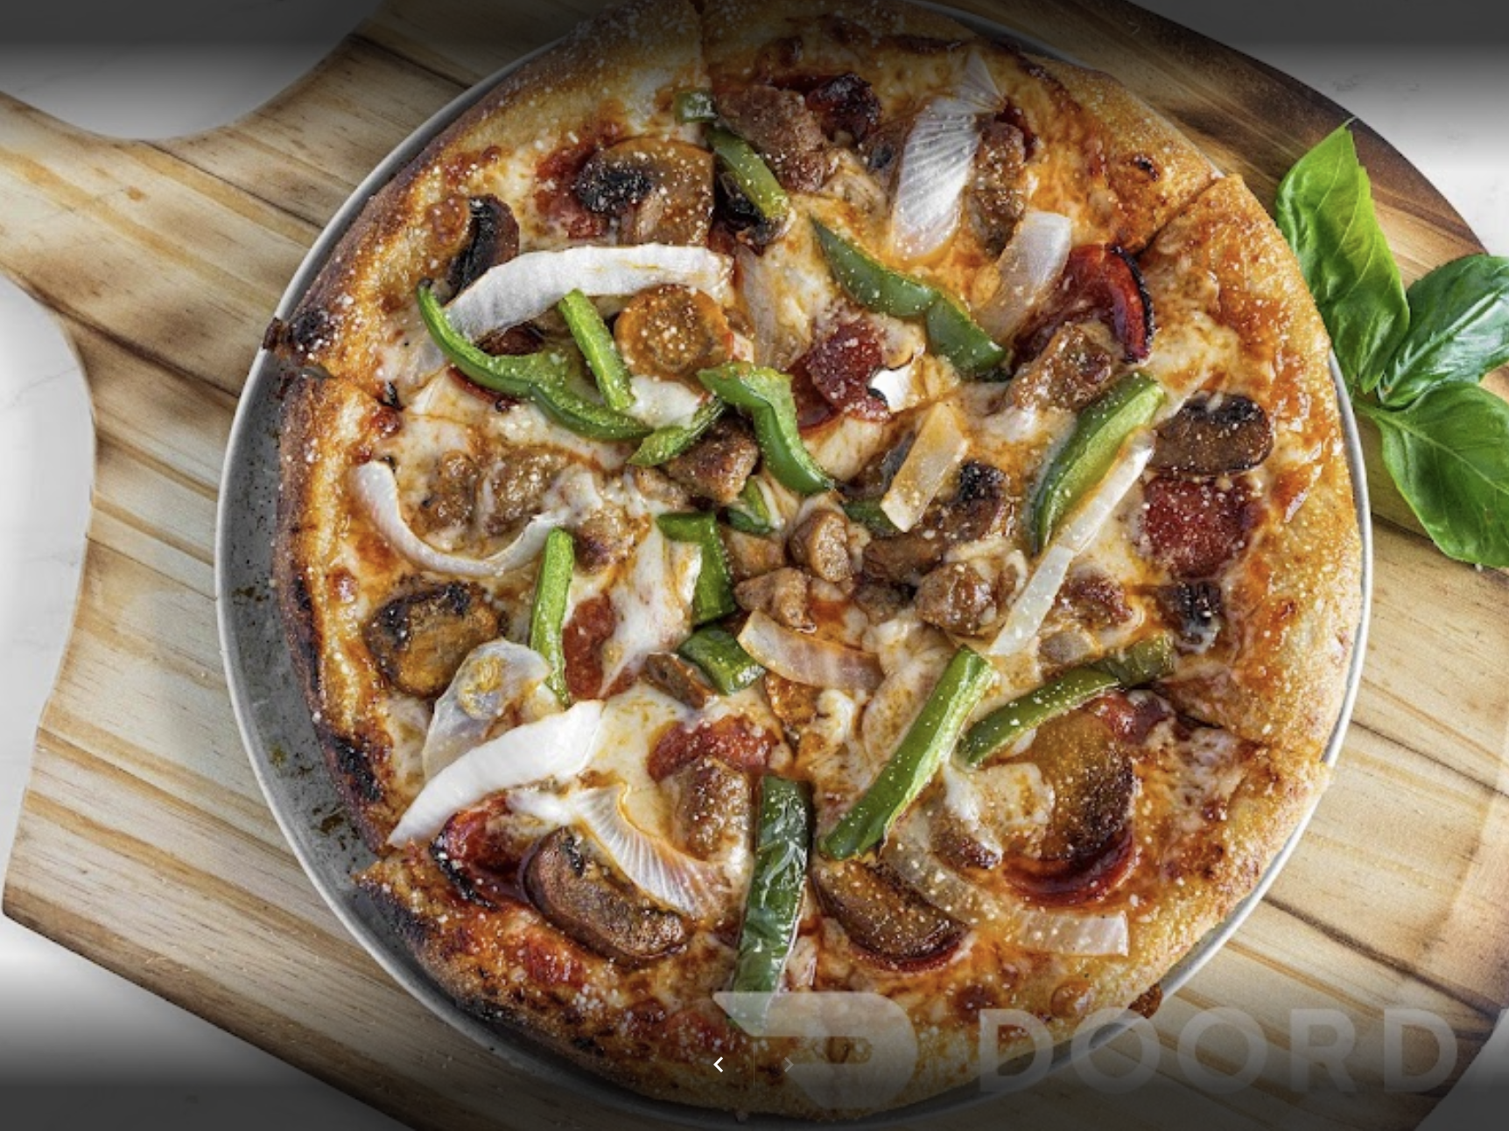
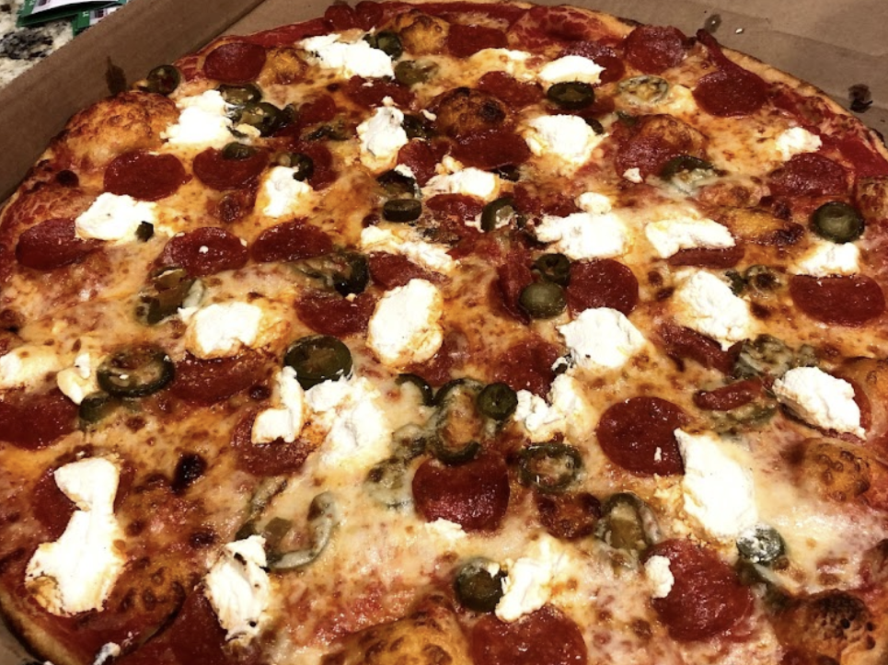
You might also like…
Filter
Filter
CLICK ON THE GLOWING BOXES/LINES TO EXPLORE!
Related sidebar
Google maps
Lookup
Automatic hyperlink
Definition
Benny Bada Bings Pizza
1815 S Tamiami Trail
4.5 $$
Translate
Unit conversion
Gulf Coast Pizza
765 U.S. 41 Bypass S
4.8 $$
Acronym/
abbreviation
Italiano’s North
1055 US-41 BYP
4.3 $$
LOAD MORE

Slide 2

You might also like…
Filter
Keyword
Exact match
Context match
Vegetarian
Benny Bada Bings Pizza
1815 S Tamiami Trail
4.5 $$
Gulf Coast Pizza
765 U.S. 41 Bypass S
4.8 $$
Italiano’s North
1055 US-41 BYP
4.3 $$
LOAD MORE

Slide 3



You might also like…
BACK
Phone: (999)999-9999
Benny Bada Bings Pizza
1815 S Tamiami Trail
4.5 $$
Gulf Coast Pizza
765 U.S. 41 Bypass S
4.8 $$
Italiano’s North
1055 US-41 BYP
4.3 $$
LOAD MORE

Slide 4
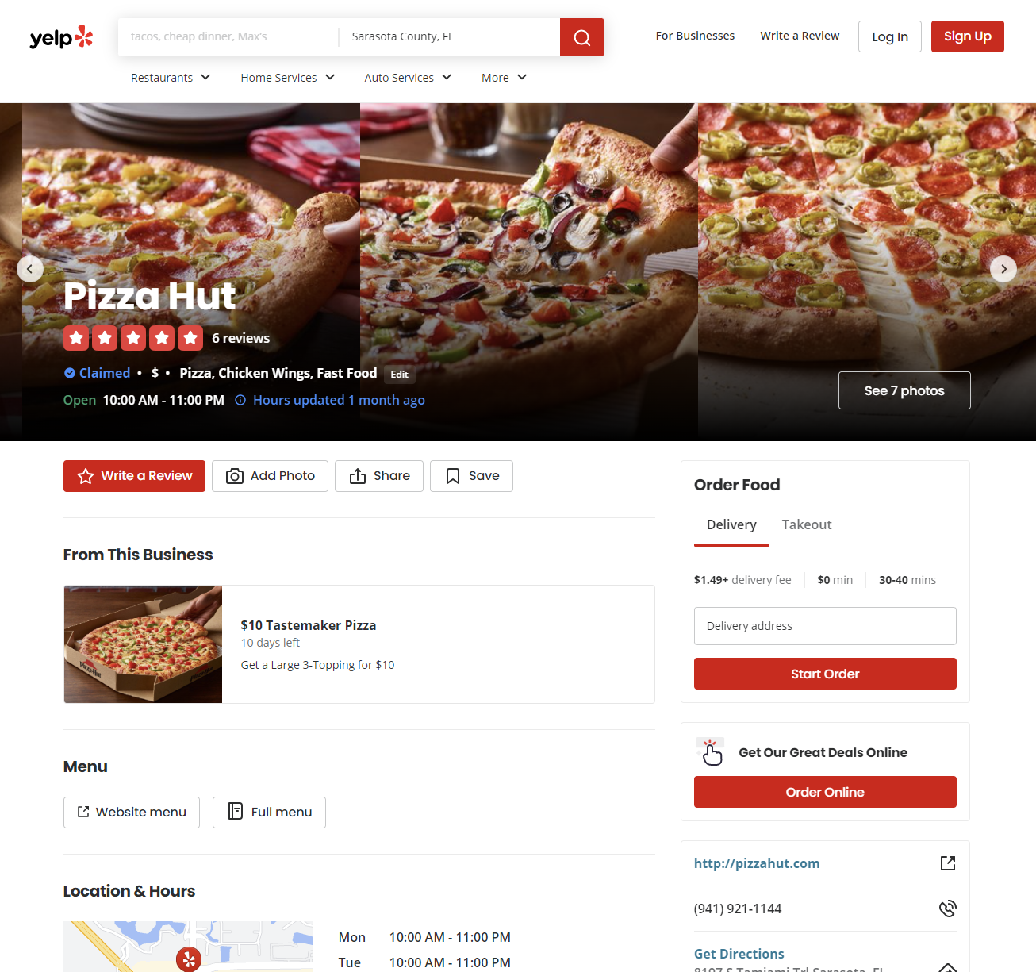
BACK

Slide 5
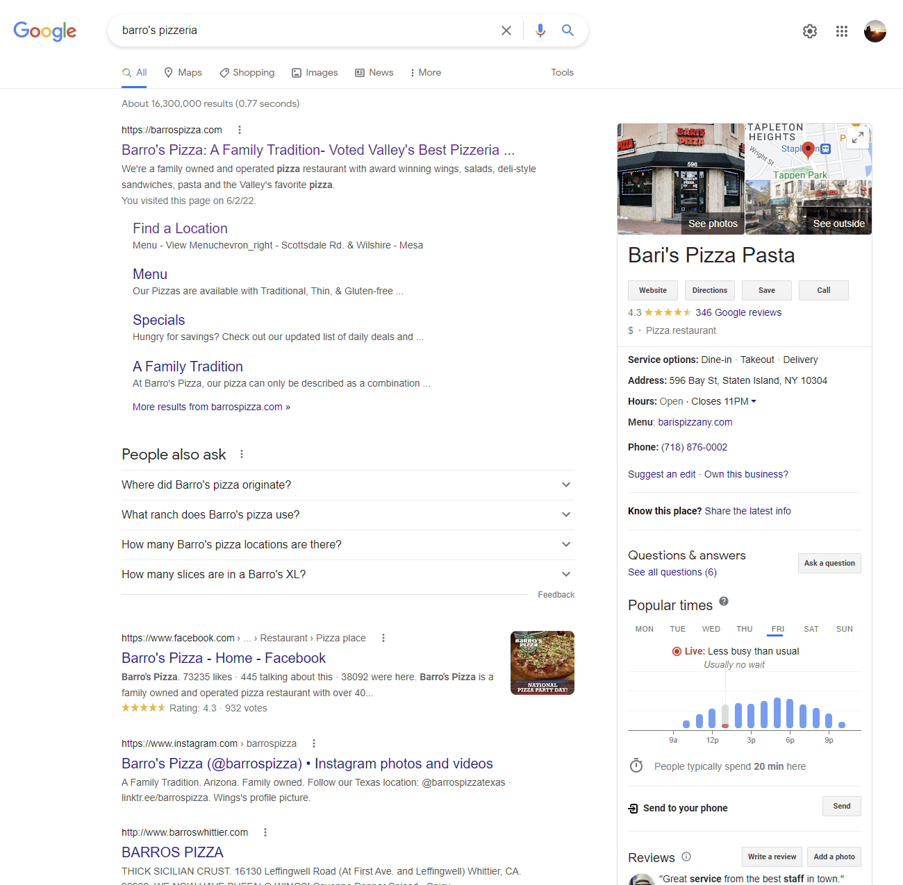
BACK

Slide 6



You might also like…
BACK
piz·ze·ri·a
/ˌpētsəˈrēə/
noun
a place where pizzas are made or sold; a pizza restaurant.
Benny Bada Bings Pizza
1815 S Tamiami Trail
4.5 $$
Gulf Coast Pizza
765 U.S. 41 Bypass S
4.8 $$
Italiano’s North
1055 US-41 BYP
4.3 $$
LOAD MORE

Slide 7

You might also like…
BACK
Benny Bada Bings Pizza
1815 S Tamiami Trail
4.5 $$
Gulf Coast Pizza
765 U.S. 41 Bypass S
4.8 $$
Italiano’s North
1055 US-41 BYP
4.3 $$
LOAD MORE

Slide 8
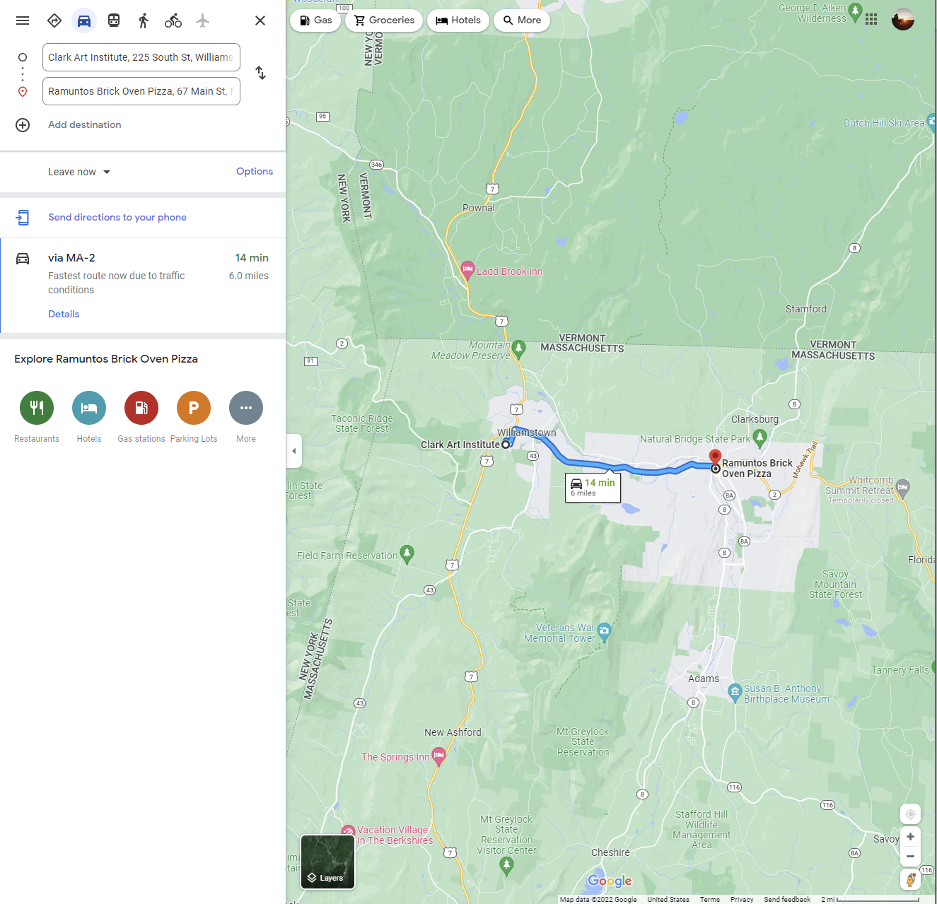
BACK

Slide 9

You might also like…
BACK
Benny Bada Bings Pizza
1815 S Tamiami Trail
4.5 $$
Gulf Coast Pizza
765 U.S. 41 Bypass S
4.8 $$
Italiano’s North
1055 US-41 BYP
4.3 $$
LOAD MORE

Slide 10
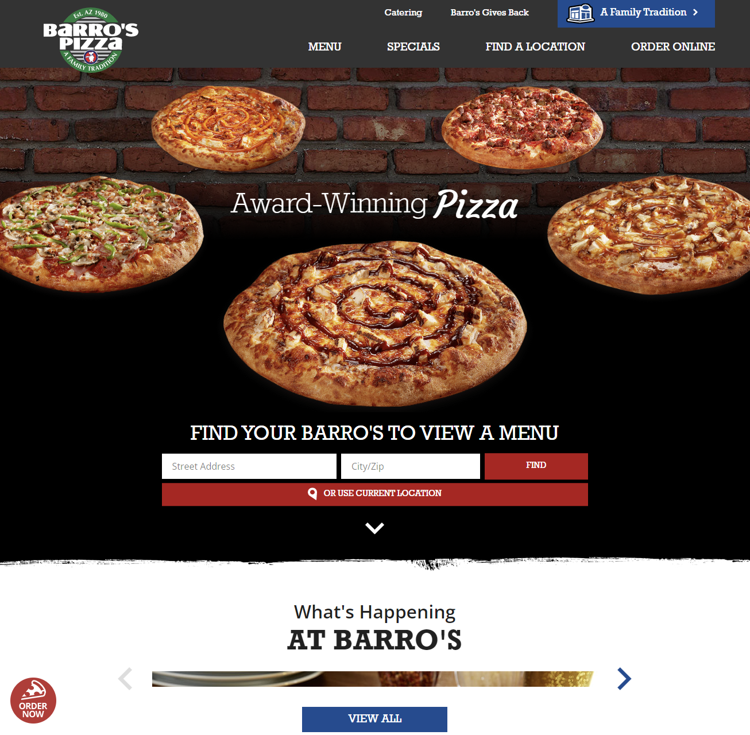
BACK

Slide 11
You might also like…
BACK
Benny Bada Bings Pizza
1815 S Tamiami Trail
4.5 $$
Translate from to
English
Chinese (simplified)
鸡肉、火腿、培根、番茄
Jīròu, huǒtuǐ, péigēn, fānqié
Gulf Coast Pizza
765 U.S. 41 Bypass S
4.8 $$
Italiano’s North
1055 US-41 BYP
4.3 $$
LOAD MORE

Slide 12

You might also like…
BACK
Benny Bada Bings Pizza
1815 S Tamiami Trail
4.5 $$
Convert
Gulf Coast Pizza
765 U.S. 41 Bypass S
4.8 $$
Currency
22.50
United State Dollar
17.88
Pound Sterling
Italiano’s North
1055 US-41 BYP
4.3 $$
LOAD MORE

Slide 13
You might also like…
BACK
Benny Bada Bings Pizza
1815 S Tamiami Trail
4.5 $$
Gulf Coast Pizza
765 U.S. 41 Bypass S
4.8 $$
BBQ
BBQ is the written abbreviation for barbecue.
Italiano’s North
1055 US-41 BYP
4.3 $$
LOAD MORE

Slide 14
You might also like…
BACK
Benny Bada Bings Pizza
1815 S Tamiami Trail
4.5 $$
Gulf Coast Pizza
765 U.S. 41 Bypass S
4.8 $$
Italiano’s North
1055 US-41 BYP
4.3 $$
LOAD MORE

Slide 15
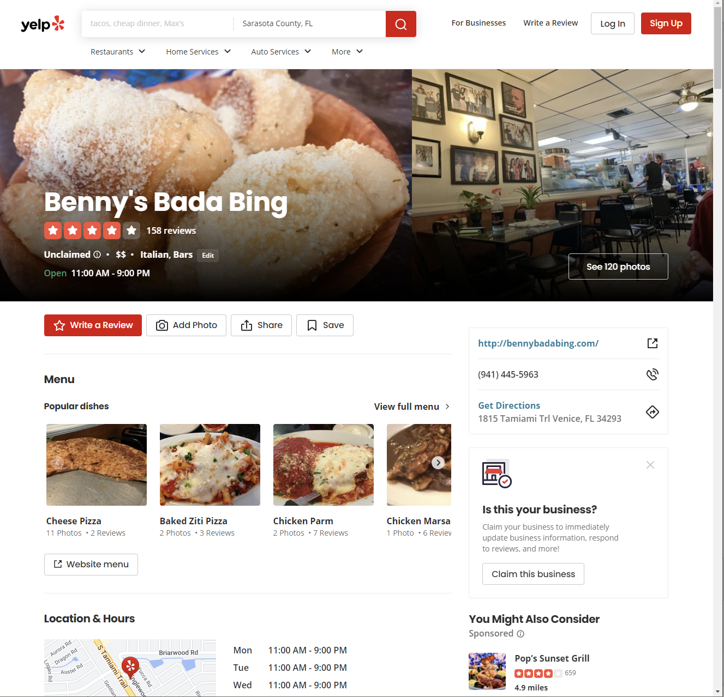
BACK

